Slide 1

STATISTICAL LEARNING & ASSOCIATION RULES MINING
ADVANCED DATA SCIENCE TRAINING I
“Data science does not replace statistical modeling and data analysis; it augments them.”
(P. Boily)
“Data is not information, information is not knowledge, knowledge is not understanding, understanding is not wisdom.”
(attributed to Cliff Stoll in Keeler's Nothing to Hide: Privacy in the 21st Century, 2006)
data-action-lab.com

Slide 2
LEARNING OBJECTIVES
Become familiar with the various statistical learning approaches (supervised, unsupervised, and so forth).
Become familiar with the fundamental concepts of association rules, and their application to data.

Slide 3
STATISTICAL LEARNING
STATISTICAL LEARNING AND ASSOCIATION RULES MINING
“We learn from failure, not from success!”
(Bram Stoker, Dracula)

Slide 4
What is Data Science? (REPRISE)
Data Science (DS) is the collection of processes by which we extract useful and actionable insights from data.
(paraphrased from T. Kwartler)
DS is the working intersection of statistics, engineering, computer science, domain expertise, and “hacking.” It involves two main thrusts: analytics (counting things) and inventing new techniques to draw insights from data.
(paraphrased from H. Mason)

Slide 5
The Mining Analogy
What are we mining? data (earth)
What are we using to mine? data mining techniques (digging tools)
What are we mining for? looking for patterns/knowledge (raw minerals)
What do we do with the raw material? describe patterns/relationships (refine minerals into something useful)
What is the output, or product? models (Ge, Ga, Si to build transistors)
What do we do with the product? apply models to evidence-based decision support (use transistor in electrical systems)

Slide 6
Learning in General
Beyond “just taking a quick look,” humans learn through:
answering questions
testing hypotheses
creating concepts
making predictions
creating categories and classifying objects
grouping objects
The central Data Science/Machine Learning problem is:
can we design algorithms that can learn?

Slide 7
Types of Learning
Supervised Learning (learning with a teacher)
classification, regression, rankings, recommendations
uses labeled training data (student gives an answer to each test question based on what they learned from worked-out examples)
performance is evaluated using testing data (teacher provides the correct answers)
Unsupervised Learning (grouping similar exercises together as a study aid)
clustering, association rules discovery, link profiling, anomaly detection
uses unlabeled observations (teacher is not involved)
accuracy cannot be evaluated (students might not end up with the same groupings)

Slide 8
Types of Learning
Semi-Supervised Learning (teacher providing worked-out examples and a list of unsolved problems)
Reinforcement Learning (embarking on a Ph.D. with an advisor)
______________________________
In supervised learning, there’s a target against which to train the model. In unsuper-vised learning, we don’t know what the target is, or even if there is one.
The distinction is crucial. Make sure you understand it.

Slide 9
EXERCISES
What are some examples of supervised and unsupervised learning tasks in the business world? In a public policy/government setting?

Slide 10
EXERCISES
Assuming that data mining techniques are used in the following cases, identify whether the required task falls under supervised (S) or unsupervised (U) learning.
Deciding whether to issue a loan to an applicant based on demographic and financial data (with reference to a database of similar data on prior customers)
In an online bookstore, making recommendations to customers concerning additional items to buy based on the buying pattern in prior transactions.
Identifying a network data packet as dangerous (virus, hacker attack) based on comparison to other packets with a known threat status.
Identifying segments of similar customers.
Predicting whether a company will go bankrupt based on comparing its financial data to those of similar bankrupt and non-bankrupt firms.

Slide 11
EXERCISES
Assuming that data mining techniques are used in the following cases, identify whether the required task falls under supervised (S) or unsupervised (U) learning.
Estimating the repair time required for an aircraft based on a trouble ticket.
Automated sorting of mail by zip code scanning.
It is more difficult and expensive to win new customers than it is to retain existing customers. Scoring each customer on their likelihood to quit can help an organization design effective interventions, such as discounts or free services, to retain profitable customers in a cost-effective manner.
Some medical practitioners conduct unnecessary tests and/or overbill their government or insurance companies. Using audit data, it may be possible to identify such providers and take appropriate action.

Slide 12
EXERCISES
Assuming that data mining techniques are used in the following cases, identify whether the required task falls under supervised (S) or unsupervised (U) learning.
A market basket analysis can help develop predictive models to determine which products often sell together. This knowledge of affinities between products can help retailers create promotional bundles to push non-selling items along a set of products that sell well.
Diagnosing the cause of a medical condition is the crucial first step in medical engagement. In addition to the current condition, other factors can be considered, including the patient’s health history, medication history, family’s history, and other environmental factors. A predictive model can absorb all of the information available to date (for this patient and others) and make probabilistic diagnoses, in the form of a decision tree, taking away most of the guess work involved.

Slide 13
EXERCISES
Assuming that data mining techniques are used in the following cases, identify whether the required task falls under supervised (S) or unsupervised (U) learning.
Schools can develop models to identify students who are at risk of not returning to school. Such students can be flagged to be on the receiving end of potential corrective measures.
In addition to customer data, telecom companies also store call detail records (CDR), which precisely describe the calling behaviour of each customer. The unique data can be used to profile customers, who may be marketed to based on the similarity of their CDR to other customers’.
Statistically, all equipment is likely to break down at some point in time. Predicting which machine is likely to shut down is a complex process. Decision models to forecast machinery failure could be constructed using past data, which can lead to savings provided by preventative maintenance.

Slide 14
Case Study: Danish Medical Study
STATISTICAL LEARNING AND ASSOCIATION RULES MINING
Temporal disease trajectories condensed from population-wide registry data covering 6.2 million patients
(Jensen, A.B., Moseley, P.L., Oprea, T.I., Ellesøe, S.G., Eriksson, R., Schmock, H., Jensen, P.B., Jensen, L.J., Brunak, S. [2014], Nature Communications).

Slide 15
Context
The Danish National Patient Registry contains 68 million health observations on 6.2 million patients over a 15 year time span (Jan ‘96 – Nov ‘10).
Objectives:
finding connections between different diagnoses
determining how a diagnosis at some point in time might allow for the prediction of another diagnosis at a later point in time

Slide 16
Methodology
Compute strength of correlation for pairs of diagnoses over a 5 year interval on a representative subset of the data
Test diagnoses pairs for directionality (one diagnosis repeatedly occurring before the other)
Determine reasonable diagnosis trajectories (thoroughfares) by combining smaller frequent trajectories with overlapping diagnoses
Validate the trajectories by comparison with non-Danish data
Cluster the thoroughfares to identify central medical conditions (key diagnoses) around which disease progression is organized

Slide 17
Results
Data was reduced to 1,171 thoroughfares on the course of
diabetes
chronic obstructive pulmonary disease (COPD)
cancer
arthritis
cardiovascular disease.
The data analysis showed, for example:
diagnoses of anemia followed later by the discovery of colon cancer
gout was identified as a step toward cardiovascular disease.
COPD is under-diagnosed and under-treated.

Slide 18
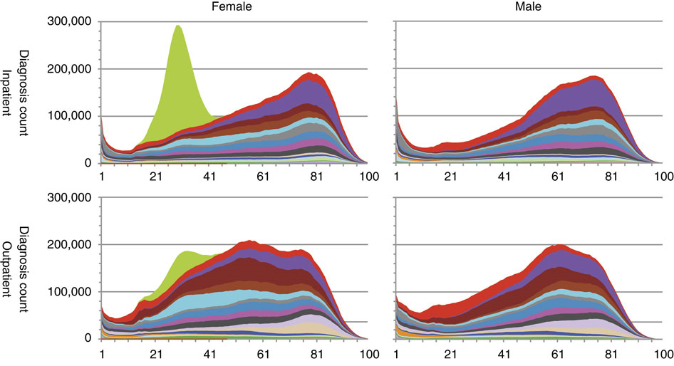

Slide 19
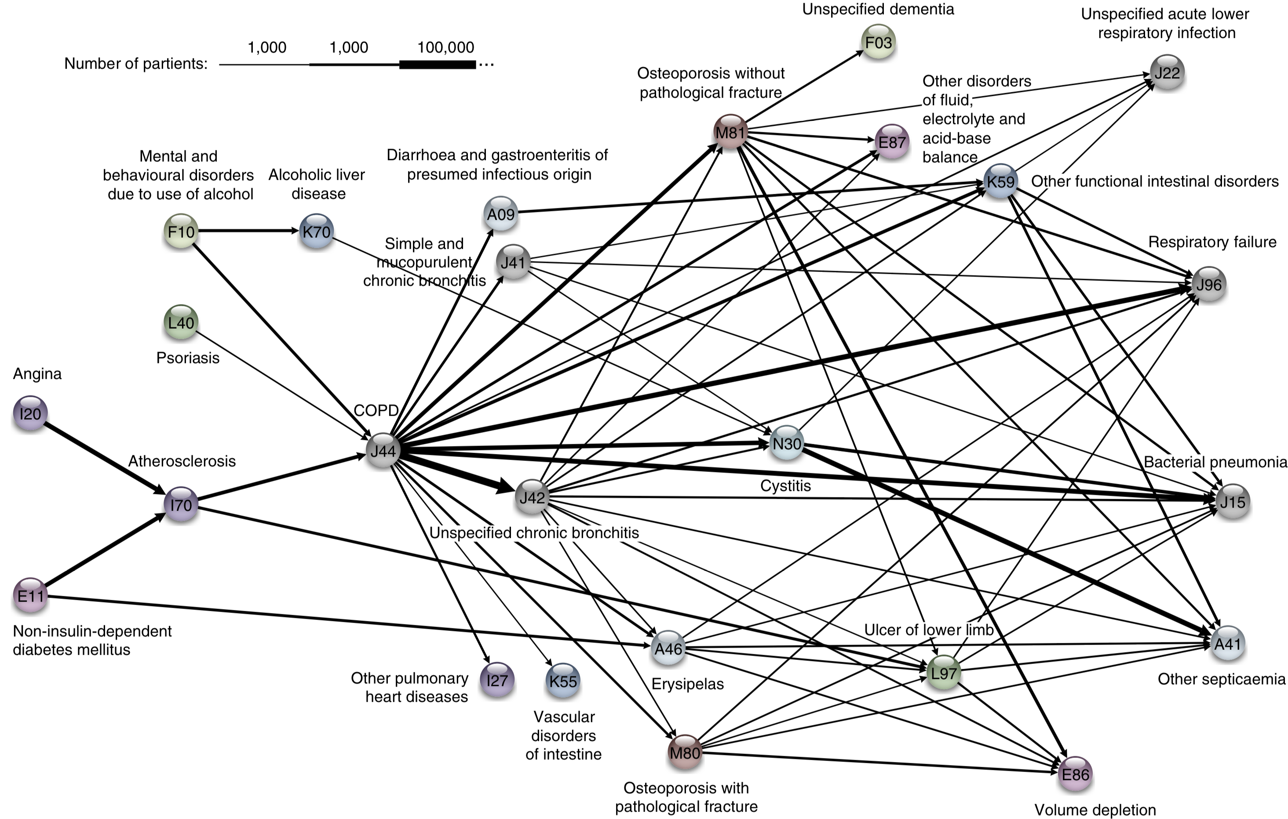

Slide 20
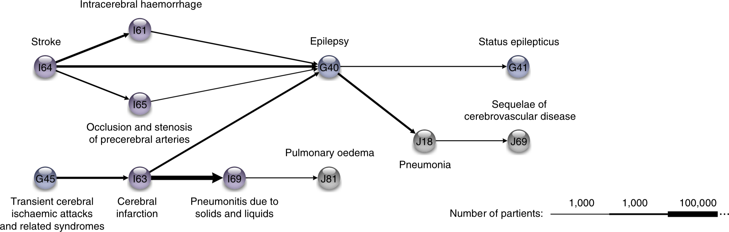
Results

Slide 21
Take-Aways
Data makes it possible to view diseases in a larger context.
The research could yield tangible health benefits as we move beyond one-size-fits-all medicine.
The sooner a health risk pattern is identified, the better we can prevent and treat critical diseases.
Instead of looking at each disease in isolation, you can talk about a complex system with many different interacting factors.
The order in which different diseases appear can help find patterns and complex correlations outlining the direction for each individual person.

Slide 22
DISCUSSION
Is this research applicable to the Canadian context? To the Chinese context?
What do you think some of the technical challenges were?

Slide 23
Association Rules Basics
STATISTICAL LEARNING AND ASSOCIATION RULES MINING
“Correlation isn’t causation. But it’s a big hint.”
(E. Tufte)

Slide 24
Association Rules Basics
Association Rule Discovery is a type of unsupervised learning that finds connections among attributes (and combinations of attributes).
Example: we might analyze a dataset on the physical activities and purchasing habits of North Americans and discover that
runners who are also triathletes (the premise) tend to drive Subarus, drink microbrews, and use smartphones (the conclusion), or
individuals who have purchased home gym equipment are unlikely to be using it 1 year later (to name some fictitious possibilities)

Slide 25
Original Application
Supermarkets record the contents of shopping carts at check-outs to determine items which are frequently purchased together.
Examples:
bread and milk are often purchased together, but that’s not so interesting given how often they are purchased individually
hot dogs and mustard are also often purchased as a pair, but more rarely purchased individually
A supermarket could then have a sale on hot dogs while raising the price on condiments.

Slide 26
Other Applications
Related Concepts
looking for pairs (triplets, etc) of words that represent a joint concept
{Ottawa, Senators}, {Michelle, Obama}, {veni, vidi, vici}, etc.
Plagiarism
looking for sentences that appear in various documents
looking for documents that share sentences
Biomarkers
diseases that are frequently associated with a set of biomarkers

Slide 27
Other Uses
Making predictions and decisions based on these rules
Alter circumstances or environment to take advantage of these correlations
Use the connections to modify the likelihood of certain outcomes
Imputing missing data
Text autofill and autocorrect

Slide 28
DISCUSSION
What are some public policy/government applications of association rules?

Slide 29
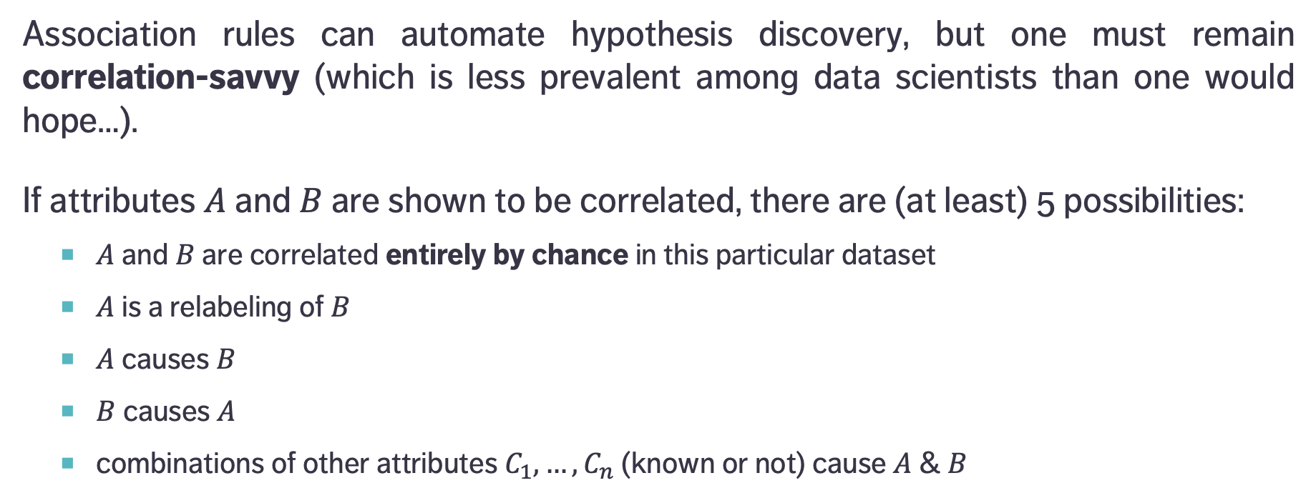
Causation and Correlation
Association rules can automate hypothesis discovery, but one must remain correlation-savvy (which is less prevalent among data scientists than one would hope…).
If attributes $A$ and $B$ are shown to be correlated, there are (at least) 5 possibilities:
$A$ and $B$ are correlated entirely by chance in this particular dataset
$A$ is a relabeling of $B$
$A$ causes $B$
$B$ causes $A$
combinations of other attributes $C_{1},…,C_{n}$ (known or not) cause $A$ & $B$

Slide 30
Causation and Correlation
[E. Siegel, Predictive Analytics: The Power to Predict Who Will Click, Buy, Lie, or Die]
Insight | Organization
Pop-Tarts before a hurricane | Walmart
Higher crime, more Uber rides | Uber
Typing with proper capitalization indicates creditworthiness | A financial services startup company
Users of the Chrome and Firefox browsers make better employees | A human resources professional services firm, over employee data from Xerox and other firms
Men who skip breakfast get more coronary heart disease | Harvard University medical researchers
More engaged employees have fewer accidents | Shell
Smart people like curly fries | Researchers at the University of Cambridge and Microsoft Research
Female-named hurricanes are more deadly | University researchers
Higher status, less polite | Researchers examining Wikipedia behavior

Slide 31
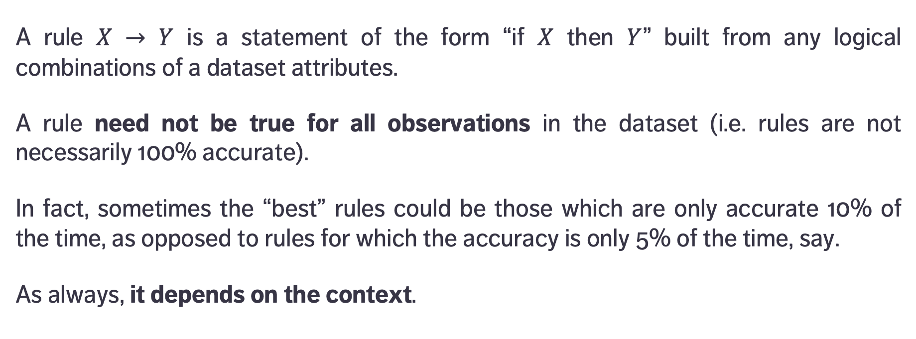
Definitions
premise
conclusion
A rule $X → Y$ is a statement of the form “if $X$ then $Y$” built from any logical combinations of a dataset attributes.
A rule need not be true for all observations in the dataset (i.e. rules are not necessarily 100% accurate).
In fact, sometimes the “best” rules could be those which are only accurate 10% of the time, as opposed to rules for which the accuracy is only 5% of the time, say.
As always, it depends on the context.

Slide 32
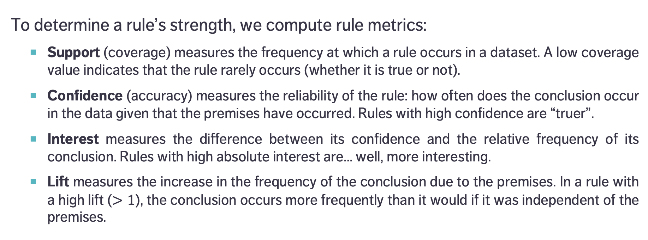
Definitions
To determine a rule’s strength, we compute rule metrics:
Support (coverage) measures the frequency at which a rule occurs in a dataset. A low coverage value indicates that the rule rarely occurs (whether it is true or not).
Confidence (accuracy) measures the reliability of the rule: how often does the conclusion occur in the data given that the premises have occurred. Rules with high confidence are “truer”.
Interest measures the difference between its confidence and the relative frequency of its conclusion. Rules with high absolute interest are… well, more interesting.
Lift measures the increase in the frequency of the conclusion due to the premises. In a rule with a high lift ($>1$), the conclusion occurs more frequently than it would if it was independent of the premises.

Slide 33
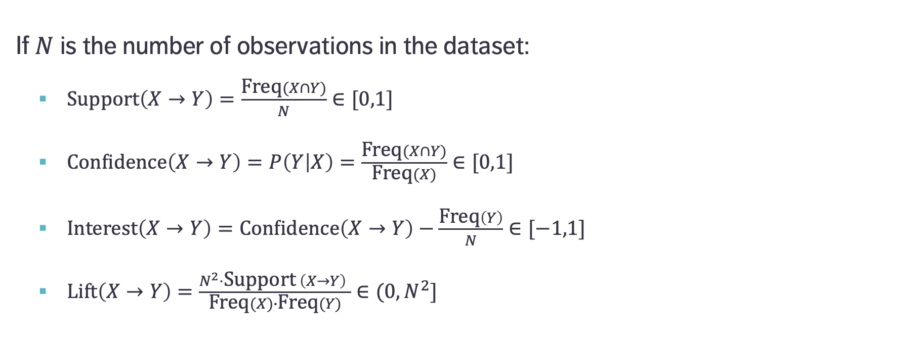
Formulas
If $N$ is the number of observations in the dataset:
$\text{Support}\left(X→Y\right)=\frac{\text{Freq}(X∩Y)}{N}∈[0,1]$
$\text{Confidence}\left(X→Y\right)=P\left(Y | X\right)=\frac{\text{Freq}(X∩Y)}{\text{Freq}(X)}∈[0,1]$
$\text{Interest}\left(X→Y\right)=\text{Confidence}\left(X→Y\right)−\frac{\text{Freq}\left(Y\right)}{N}∈[−1,1]$
$\text{Lift}\left(X→Y\right)=\frac{N^{2}⋅\text{Support} \left(X→Y\right) }{\text{Freq}(X)∙\text{Freq}(Y)}∈(0,N^{2}]$
Proportion of instances where the premise and the conclusion occur together
Proportion of instances where the conclusion occurs when the premise occurs
… ?!?

Slide 34
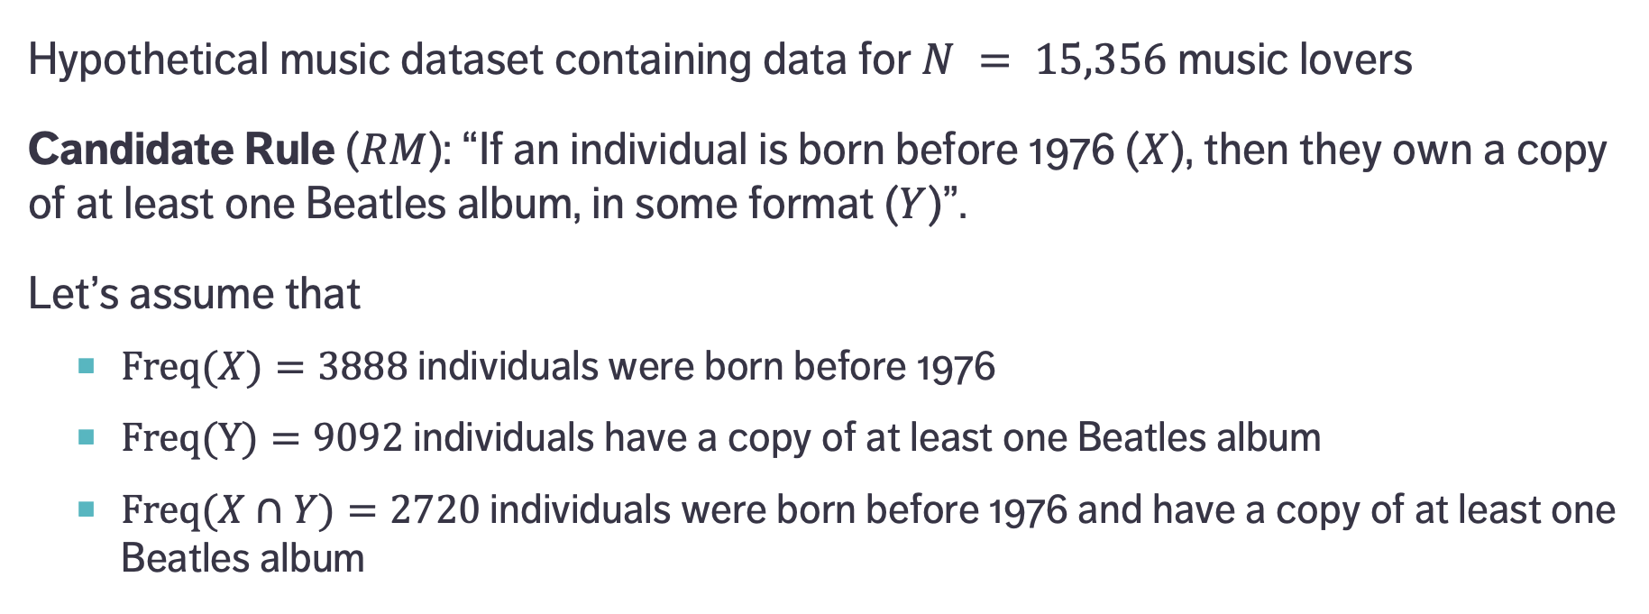
A Simple Example
Hypothetical music dataset containing data for $N = 15,356$ music lovers
Candidate Rule ($RM$): “If an individual is born before 1976 ($X$), then they own a copy of at least one Beatles album, in some format ($Y$)”.
Let’s assume that
$\text{Freq}(X)=3888$individuals were born before 1976
$\text{Freq}(Y)=9092$ individuals have a copy of at least one Beatles album
$\text{Freq}(X∩Y)=2720$ individuals were born before 1976 and have a copy of at least one Beatles album
Notes:
Lift: 70% of those who were born before 1976 own a copy, whereas 56% of those who were born after 1976 own a copy – there is a difference, but it is not large).

Slide 35
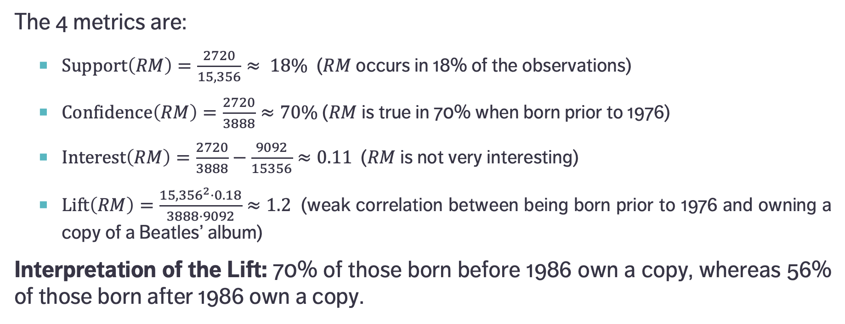
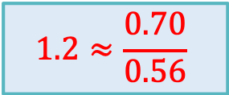
A Simple Example
$$1.2≈\frac{0.70}{0.56}$$
The 4 metrics are:
$\text{Support}\left(RM\right)=\frac{2720}{15,356}≈ 18\%$ ($RM$ occurs in 18% of the observations)
$\text{Confidence}\left(RM\right)=\frac{2720}{3888}≈70\%$ ($RM$ is true in 70% when born prior to 1976)
$\text{Interest}\left(RM\right)=\frac{2720}{3888}−\frac{9092}{15356}≈0.11$ ($RM$ is not very interesting)
$\text{Lift}\left(RM\right)=\frac{{15,356}^{2}⋅0.18}{3888⋅9092}≈1.2$ (weak correlation between being born prior to 1976 and owning a copy of a Beatles’ album)
Interpretation of the Lift: 70% of those born before 1986 own a copy, whereas 56% of those born after 1986 own a copy.

Slide 36
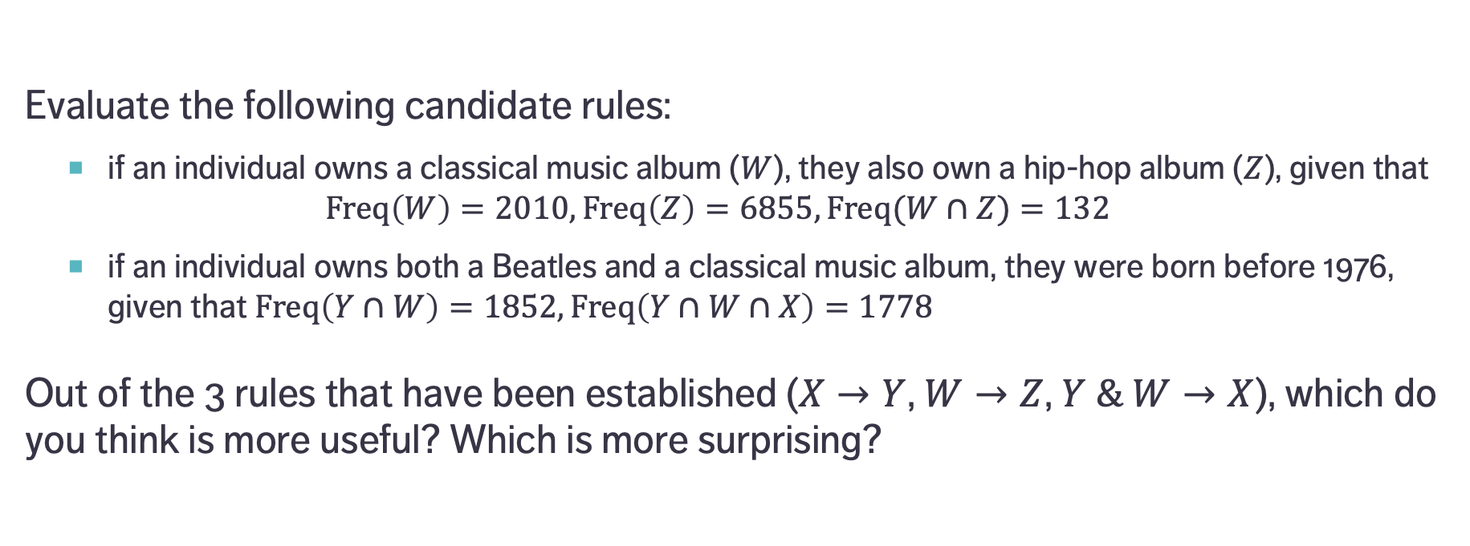
EXERCISE
Evaluate the following candidate rules:
if an individual owns a classical music album ($W$), they also own a hip-hop album ($Z$), given that $\text{Freq}\left(W\right)=2010,\text{Freq}\left(Z\right)=6855,\text{Freq}(W∩Z)=132$
if an individual owns both a Beatles and a classical music album, they were born before 1976, given that $\text{Freq}\left(Y∩W\right)=1852,\text{Freq}\left(Y∩W∩X\right)=1778$
Out of the 3 rules that have been established ($X→Y$, $W→Z$, $Y \& W→X$), which do you think is more useful? Which is more surprising?

Slide 37
Brute Force Algorithm
Generate item sets (of size 1, 2, 3, 4, etc.)
e.g. {purchasing = Typical, membership = False, coupon = Yes}
Create rules from each item set
e.g. IF (purchasing = Typical AND membership = False) THEN coupon = Yes
Calculate the support, confidence, interest, lift for each rule
Retain only the rules with “high enough” coverage, accuracy, interest, and/or lift (or other metrics)
These rules are considered to be true for the dataset – they are new knowledge derived from the data

Slide 38
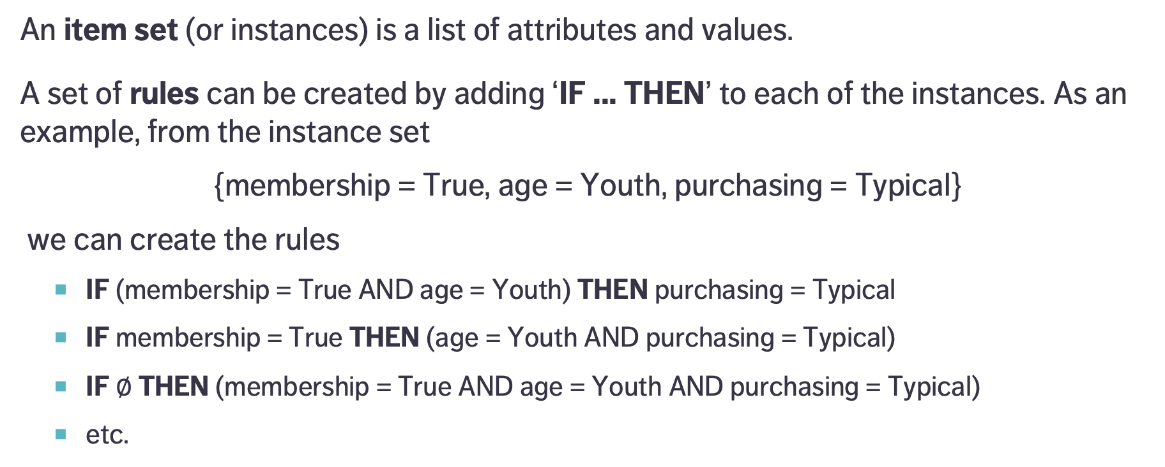
Generating Rules
An item set (or instances) is a list of attributes and values.
A set of rules can be created by adding ‘IF ... THEN’ to each of the instances. As an example, from the instance set
{membership = True, age = Youth, purchasing = Typical}
we can create the rules
IF (membership = True AND age = Youth) THEN purchasing = Typical
IF membership = True THEN (age = Youth AND purchasing = Typical)
IF $∅$ THEN (membership = True AND age = Youth AND purchasing = Typical)
etc.
Parentheses are usually dropped

Slide 39
EXERCISE
A store that sells accessories for cellular phones runs a promotion on faceplates.
Customers who purchase multiple faceplates from a choice of 6 different colours get a discount. The store managers, who would like to know what colours of faceplates are likely to be purchased together, collected past transactions in Transactions.csv.
Consider the following rules:
{red, white} ⇒ {green}
{green} ⇒ {white}
{red, green} ⇒ {white}
{green} ⇒ {red}
{orange} ⇒ {red}
{white, black} ⇒ {yellow}
{black} ⇒ {green}
Notes:
Intro to text analysis
We will be talking about data reduction using NHL game between Ottawa Senators vs. Toronto Maple Leafs on February 18th of 2017

Slide 40
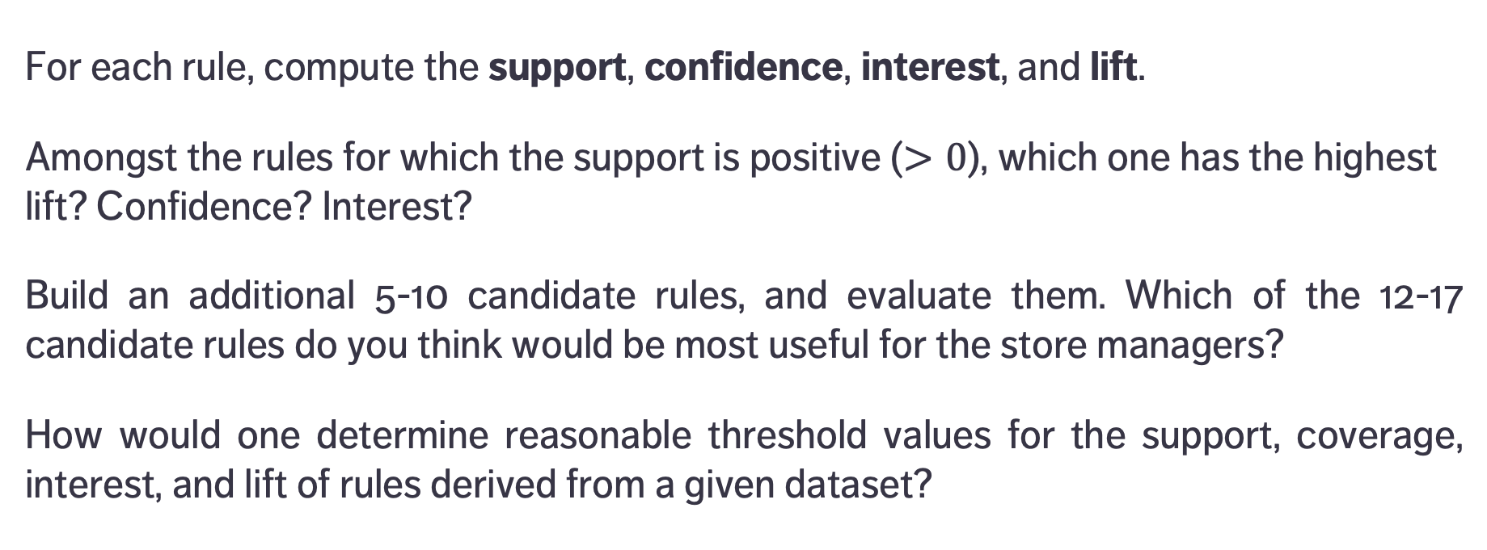
EXERCISE
For each rule, compute the support, confidence, interest, and lift.
Amongst the rules for which the support is positive ($>0$), which one has the highest lift? Confidence? Interest?
Build an additional 5-10 candidate rules, and evaluate them. Which of the 12-17 candidate rules do you think would be most useful for the store managers?
How would one determine reasonable threshold values for the support, coverage, interest, and lift of rules derived from a given dataset?

Slide 41
Notes and Validation
STATISTICAL LEARNING AND ASSOCIATION RULES MINING
“Remember that all models are wrong; the practical question is how wrong do they have to be before they are not useful anymore.”
(Box, G.E.P., and Draper, N. R., Empirical Model Building and Response Surfaces)

Slide 42
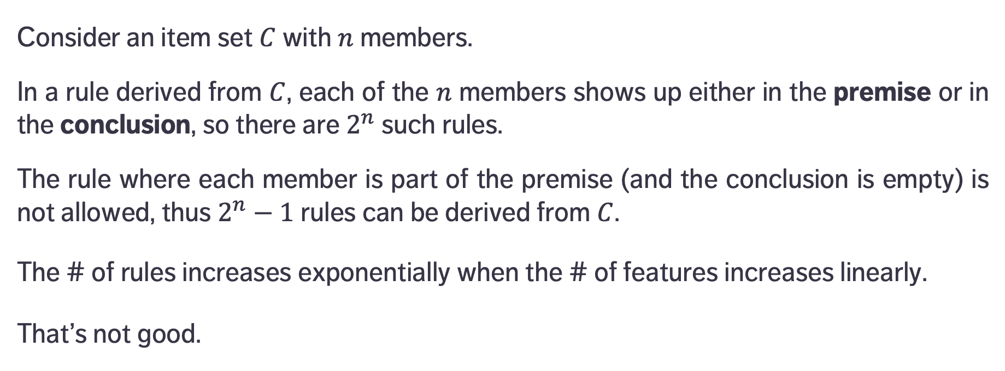
Number of Rules
Consider an item set $C$ with $n$ members.
In a rule derived from $C$, each of the $n$ members shows up either in the premise or in the conclusion, so there are $2^{n}$ such rules.
The rule where each member is part of the premise (and the conclusion is empty) is not allowed, thus $2^{n}−1$ rules can be derived from $C$.
The # of rules increases exponentially when the # of features increases linearly.
That’s not good.

Slide 43
Validation
The brute force algorithm works relatively well for small datasets (small number of features).
For Big(ger) Data, it can be costly to generate rules in that fashion (especially when the number of attributes increases). How do we generate promising candidate rules, in general?
How reliable are association rules? What is the likelihood that they occur by chance? How relevant are they? Can they be generalized outside the dataset, or to new data?

Slide 44
Notes
Since frequent rules correspond to instances that occur repeatedly in the dataset, algorithms that generate item sets often try to maximize coverage.
When rare events are more meaningful (such as detection of a rare disease), we need algorithms that can generate rare item sets. This is not a trivial problem.
A reminder, in spite of Tufte’s rejoinder: correlation is not causation.

Slide 45
Other Algorithms
Continuous vs. Categorical: continuous data has to be binned into categorical data in order for association rules to be meaningful. There’s more than one way to do that.
Item sets are sometimes called market baskets.
Other algorithms:
AIS, SETM, Apriori, AprioriTid, AprioriHybrid, Eclat, PCY, Multistage, Multihash, etc.

Slide 46
THE A Priori Algorithm
STATISTICAL LEARNING AND ASSOCIATION RULES MINING
MR. SNIFF: What are you looking for? MR. SNOOP: A five-dollar bill. MR. SNIFF: Are you sure you lost it on this street? MR. SNOOP: Oh no! I lost it in the next block, but I’m lookin’ up here because the light is better.
(Boys’ Life Magazine, 1932)

Slide 47
Apriori Algoritm
Developed initially for transaction data
every reasonable dataset can be transformed into a transaction dataset using dummy variables
Finds frequent item sets from which to build candidate rules
instead of building rules from all possible item sets
Starts by identifying frequent individual items in the database and extends them to larger and larger item sets, assuming these are still found frequently enough in the dataset
bottom-up approach, uses the downward closure property of support
Notes:
Developed initially for transaction data (but every data set can be transformed into a transaction dataset using dummy variables).

Slide 48
Apriori Algoritm
Prunes candidates which have infrequent sub-patterns
requires a support threshold
that threshold has to be set sufficiently high to minimize the number of frequent item sets
If a 1-item set is not frequent, any 2-item set containing it is also infrequent, for instance.
The algorithm terminates when no further successful extensions are found.
Notes:
Developed initially for transaction data (but every data set can be transformed into a transaction dataset using dummy variables).

Slide 49
Strengths and Limitations
Easy to implement, easily parallelized.
Apriori is slow and it requires frequent data set scans.
possible solutions: sampling and partitioning
Not ideal at finding rules for infrequent or rare item sets.
Other algorithms have since displaced it (historical value):
Max-Miner tries to identify frequent item sets without enumerating them; performs jumps in space instead of using bottom-up approach
Eclat is faster and uses depth-first search, but requires extensive memory storage

Slide 50
Example: Titanic
STATISTICAL LEARNING AND ASSOCIATION RULES MINING
“Oh they built the ship Titanic to sail the ocean blue; And they thought they had a ship that the water wouldn’t go through; But Fate’s almighty hand knew the ship would never stand. It was sad when that great ship went down.”
(The Titanic Disaster, Traditional Folk Song)

Slide 51
Titanic Dataset
Compiled by Robert Dawson in 1995; it consists of 4 categorical attributes for each of the 2201 people aboard the Titanic when it sank in 1912.
Attributes are:
class (first class, second class, third class, crewmember)
age (adult, child)
sex (male, female)
survival (yes, no)

Slide 52
Titanic Dataset
The natural question of interest for this dataset is how survival relates to the other attributes.
We use the arules implementation of apriori in R to generate and prune candidate rules, eventually leading to 8 rules.
_______________________
Is this a supervised or an unsupervised task?
Notes:
Intro to text analysis
We will be talking about data reduction using NHL game between Ottawa Senators vs. Toronto Maple Leafs on February 18th of 2017

Slide 53
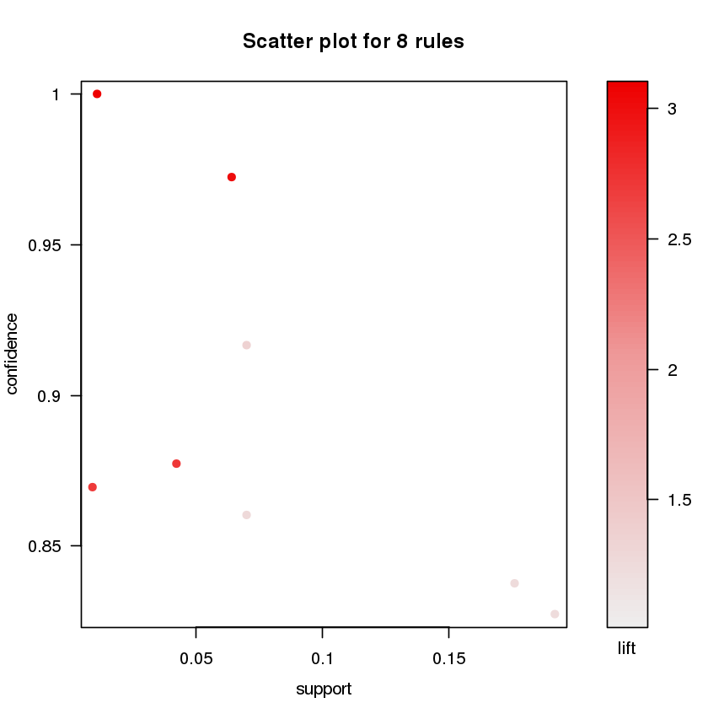
Titanic Dataset
Rule | Supp | Conf | Lift
IF class = 2nd AND age = Child THEN survived = Yes | 0.01 | 1 | 3.10
IF class = 1st AND sex = Female THEN survived = Yes | 0.06 | 0.97 | 3.01
IF class = 2nd AND sex = Female THEN survived = Yes | 0.04 | 0.88 | 2.72
IF class = Crew AND sex = Female THEN survived = Yes | 0.00 | 0.87 | 2.70
IF class = 2nd AND sex = Male AND age = Adult THEN survived = No | 0.07 | 0.92 | 1.35
IF class = 2nd AND sex = Male THEN survived = No | 0.07 | 0.86 | 1.27
IF class = 3rd AND sex = Male AND age = Adult THEN survived = No | 0.18 | 0.84 | 1.24
IF class = 3rd AND sex = Male THEN survived = No | 0.19 | 0.83 | 1.22

Slide 54
Titanic Dataset
Rule | Supp | Conf | Lift
IF class = 2nd AND age = Child THEN survived = Yes | 0.01 | 1 | 3.10
IF class = 1st AND sex = Female THEN survived = Yes | 0.06 | 0.97 | 3.01
IF class = 2nd AND sex = Female THEN survived = Yes | 0.04 | 0.88 | 2.72
IF class = Crew AND sex = Female THEN survived = Yes | 0.00 | 0.87 | 2.70
IF class = 2nd AND sex = Male AND age = Adult THEN survived = No | 0.07 | 0.92 | 1.35
IF class = 2nd AND sex = Male THEN survived = No | 0.07 | 0.86 | 1.27
IF class = 3rd AND sex = Male AND age = Adult THEN survived = No | 0.18 | 0.84 | 1.24
IF class = 3rd AND sex = Male THEN survived = No | 0.19 | 0.83 | 1.22

Slide 55
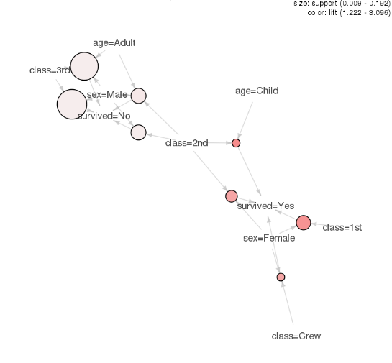
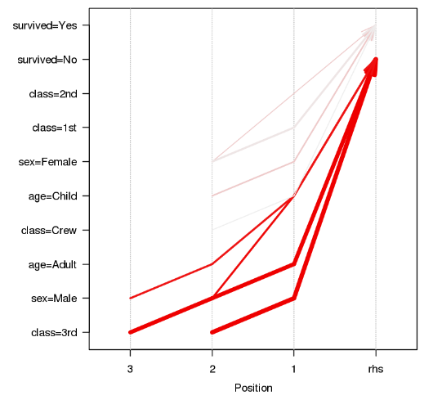
Titanic Dataset

Slide 56
Titanic Dataset

Slide 57
Titanic Dataset

Slide 58
Titanic Dataset

Slide 59
Titanic Dataset

Slide 60
EXERCISE
Conduct a similar analysis to obtain association rules related to the Life in L.A. and Transactions datasets.

Slide 61
References
STATISTICAL LEARNING AND ASSOCIATION RULES MINING

Slide 62
References
Brossette, S.E., Sprague, A.P., Hardin, J.M., Waites, K.B., Jones, W.T., Moser, S.A. (1998), Association Rules and Data Mining in Hospital Infection Control and Public Health Surveillance, Journal of American Medical Informatics Association, Vol.5, No.4, pp.373-381
Garcia, E., Romero, C., Ventura, S., Calders, T. (2007), Drawbacks and solutions of applying association rule mining in learning management systems, Proceedings of the International Workshop on Applying Data Mining in e-Learning 2007.
Boily, P., Schellinck, J., Hagiwara, S. [2019], Introduction to Quantitative Consulting, Data Action Lab.
Aggarwal, C.C., [2015], Data Mining: The Textbook, Springer.
Aggarwal, C.C., Han, J. (eds.) [2014], Frequent Pattern Mining, Springer.

Slide 63
References
http://www.rdatamining.com/examples/association-rules
https://cran.r-project.org/web/packages/arules/vignettes/arules.pdf
https://cran.r-project.org/web/packages/arulesViz/vignettes/arulesViz.pdf
https://www.lynda.com/R-tutorials/Up-Running-R/120612-2.html
http://michael.hahsler.net/research/arules_RUG_2015/demo/

